Slide 1

St. Louis Day of Dot Net 2011
Building Web Parts for an Office 365 SharePoint Site
Becky Bertram
Independent SharePoint Consultant
SharePoint MVP, MCSD.NET, MCTS
www.beckybertram.com
@beckybertram

Slide 2
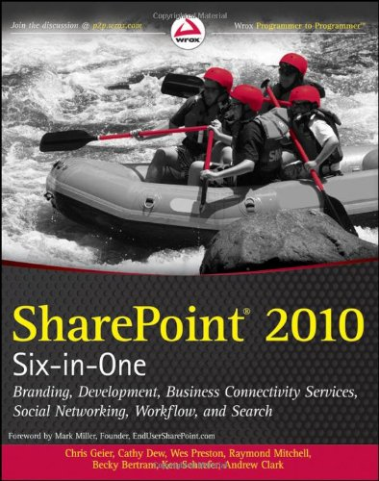
SharePoint Six-in-One
The information in this presentation is condensed from chapters 7 and 8, authored by myself, in “SharePoint 2010 Six-in-One”, published by Wrox.

Slide 3
Topics
What makes up a web part?
What is a SharePoint feature?
What is a SharePoint solution?
What’s a sandboxed solution?
Using Visual Studio 2010 with SharePoint
Understanding Office 365 SharePoint Sites

Slide 4
Understanding Web Parts

Slide 5
What is a Web Part?
Simply a Web Control, which inherits from System.Web.UI.WebControls.WebParts.WebPart
Has special “plumbing” to allow it to be moved around a SharePoint page. Has uniform properties such as size, “chrome”, etc.
Contains other controls.
“Visual” Web Part contains a User Control, which can be used to visually design your web part.

Slide 6
What Can Web Parts Be Used For?
Anything!
Can be used to access data within SharPoint
Good starting point for ASP.NET developers. Basically same process as writing an ASP.NET User Control.
Note: Keep in mind that you won’t have as much flexibility with an O365 site as you’d have if you owned the farm.

Slide 7
Web Part Files
Assembly
Configuration file (.webpart or legacy .dwp extension): Title, Chrome type, assembly and type name, etc.
Element manifest: tells SharePoint how to add Web Part to the Web Part Gallery, including what the Web Part’s title, group name should be.

Slide 8
Features and Solutions

Slide 9
What is a SharePoint Feature?
A unit of functionality within SharePoint that can be turned on, or “activated”.
Hard to describe because it can be essentially any piece of functionality in SharePoint.
  Usually, either code is executed, or content is added to a content database (i.e. something is changed in a site collection or site).
You could write a feature to:
  Add a site column, content type, or list to a site.
  Add an item to a list
  Start a timer job.
  Kick off a workflow
  Add a web part to the web part gallery
  Add a web part to a page.

Slide 10
Scope
4 different scopes: Farm, Web Application, Site Collection, Site
A feature can be activated only once per item at the given scope. (For instance, a feature scoped to the Site Collection level could be activated in both the “HR” and “IT” site collections, but it could only be activated once in the HR site collection and activated only once in the IT site collection.)
Examples: Feature that deploys a master page would be scoped to Site Collection level, while feature that adds a particular document library to a site could be scoped to the Site level.

Slide 11
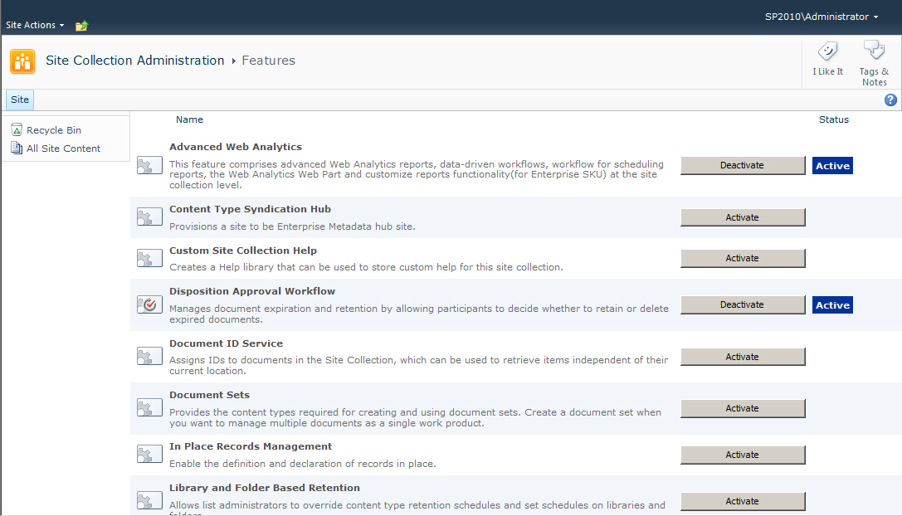
Feature Activation/Deactivation
Features can be activated or deactivated via the browser or by using PowerShell

Slide 12
What is a Solution?
A solution package is just a cabinet file with an extension of WSP.
A solution is a mechanism for deploying assets to your SharePoint server farm.
  Assets: assembly, files, features
  Manifest: solution properties, assembly location, feature location, web.config changes
Solutions work across a load balanced farm.

Slide 13
Sandboxed vs. Farm Solutions
Farm solutions deploy assets to the server file system and assemblies are executed from within the web server process.
Sandboxed solutions are extracted and run within their own separate “sandboxed” process, and are thus safer.
Sandboxed solutions have reduced functionality, but are safer to use when the site is co-located (as in an O365 site). Sandboxed solutions can be deployed by site administrators, whereas farm solutions must be deployed by server admins.
Resource throttling prevents “rogue” sandboxed solutions from chewing up server resources.
Farm solutions added to server via PowerShell (or STSADM tool), deployed via PowerShell or Central Admin. Sandboxed solutions uploaded to Solutions Gallery, deployed from there.

Slide 14
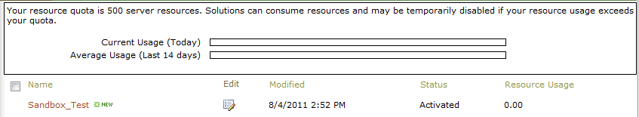
Solutions Gallery
Only in the top level site
Only site collection administrators can activate sandboxed solutions
Access via the Site Settings page of top level site.

Slide 15
Visual Studio 2010
Visual Studio 2010 must be used to build SharePoint 2010 applications.
You can use Visual Studio 2010 to build SharePoint 2007 solution packages, but you still have to do the manual work to compile the packages.
You cannot use VS 2008 to build SP2010 solutions.
Visual Studio 2010 comes with a number of built in project templates that can serve as a starting point for building SharePoint solutions, (including “Web Part” and “Visual Web Part”.)
Built-in debugging functionality

Slide 16
VS Third Party Add-Ons
SharePoint Power Tools: http://visualstudiogallery.msdn.microsoft.com/8e602a8c-6714-4549-9e95-f3700344b0d9/
CKS-Dev:
http://cksdev.codeplex.com/
(Download from within VS IDE)

Slide 17
Kinds of Web Parts
(Compiled) Web Part: Written using just .NET code.
Visual Web Part: Web Part contains a single control, which is a User Control. User Control deployed to the CONTROLTEMPLATES folder on the web server.
Sandbox-enabled Visual Web Part: Enabled with the Visual Studio Power Tools for SharePoint. Allows you to use Visual Web Part with sandboxed solutions.

Slide 18
Demo: Creating a Sandboxed Web Part

Slide 19
Office 365 Site Collection
Top level site of the site collection is your public site. (For example, http://beckybertram.sharepoint.com)
Team Site sits inside top level site, but does not have anonymous access enabled by default.
Sandboxed solutions must be deployed to Solutions gallery in the top level site.
Link to site settings not available from site actions menu. Navigate directly: /_layouts/settings.aspx.

Slide 20
Demo: Deploying Web Parts to an O365 Site

Slide 21
St. Louis SharePoint Users Group
http://www.stlsug.org

Slide 22
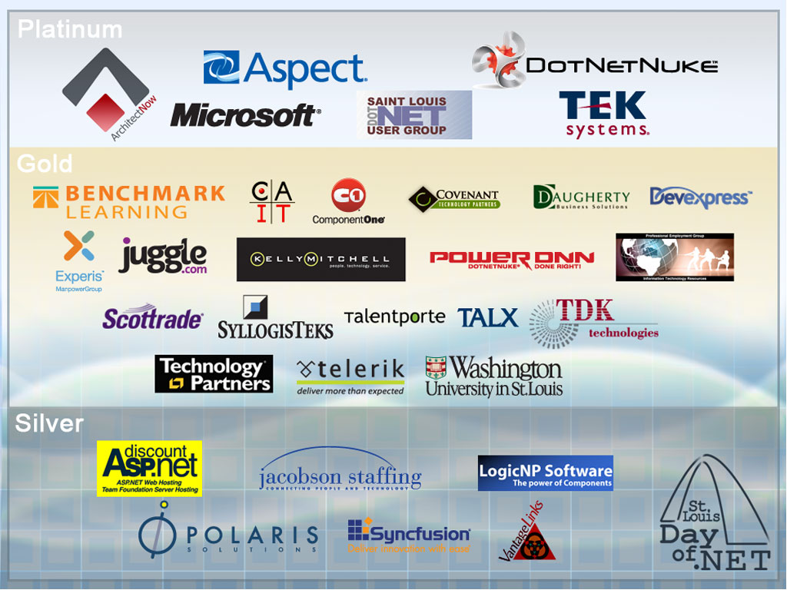

Slide 23
Questions?

